Slide 1

Velocity Moto: Accelerating the Digital Ride
A centralized, interactive platform for motorcycle enthusiasts, designed for speed and clarity.

Slide 2

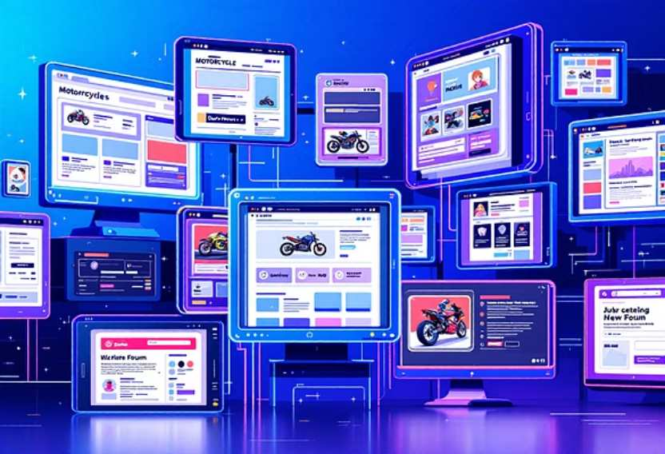
THE NEED FOR SPEED AND INFORMATION
The Scattered Ride
Motorcycle enthusiasts are struggling. Up-to-date, essential content on the latest bikes, events, and racing news is scattered across countless digital sources.
The Problem
The Solution: Velocity Moto
Information is fragmented and hard to collate.
One centralized platform for all motorcycle content.
Lack of a single, interactive hub for community engagement.
Organised, user-friendly, and up-to-date information.
Time wasted searching instead of riding or reading.
A seamless digital experience to fuel the passion.

Slide 3








Project Objectives: Detailed Insights, Effortless Access
New Bike Models
Racing Events
Detailed specifications, high-resolution imagery, and accurate pricing.
Comprehensive calendar of upcoming races with dates, venues, and details.
Interactive Experience
Community News
User-friendly design for enthusiasts of all technical levels.
Latest news and updates from the global motorcycle community.

Slide 4

CORE FEATURES & AUDIENCE FOCUS
Designed for the Rider
100%
75%
Key Functional Priorities
Motorcycle Enthusiasts
Potential Buyers
Bike Catalog & Specs
The core base: passionate about bikes and performance.
Need specs, pricing, and visual comparisons before purchase.
1
50%
Racing Calendar
2
Racing Fans
Follow the action, schedules, and event locations.
Responsive Design
3
Intuitive Search
4

Slide 5



Technical Foundations and Performance
The platform is built on modern, agile technologies, ensuring speed, scalability, and security from day one.
Non-Functional Requirements
Technology Stack
Frontend
HTML5, CSS3, JavaScript
Sub-3 Second Load
Backend
Node.js / PHP (Optional for dynamic content)
High performance is non-negotiable for a premium user experience.
Database
MySQL / Firebase (Bike/Event Data)
Hosting
Optimized Web Host
Secure Data
Protecting user interaction and feedback via secure protocols.
Scalability
Built to support future growth in bikes, events, and user load.
Usability
Intuitive navigation for both novice and expert enthusiasts.

Slide 6

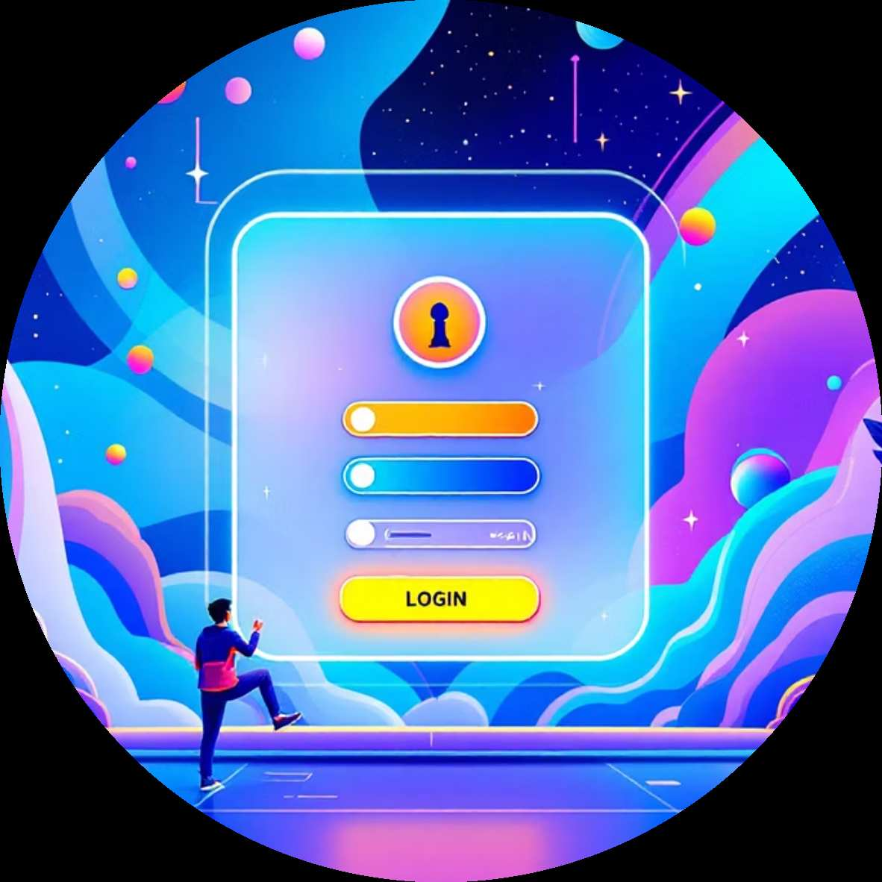

THE ROAD AHEAD
Driving Future Engagement
Achieving initial success through key metrics will pave the way for exciting future platform enhancements.
Success: Accurate Data
Enhancement: User Accounts
Enhancement: Community Features
Measure against accurate, up-to-date bike and event information.
Allow users to save favorites, set race notifications, and customize the experience.
Add comments, reviews, and social media integration for sharing news.
Velocity Moto is more than a website; it's the digital home for the riding community.

